Slide 1
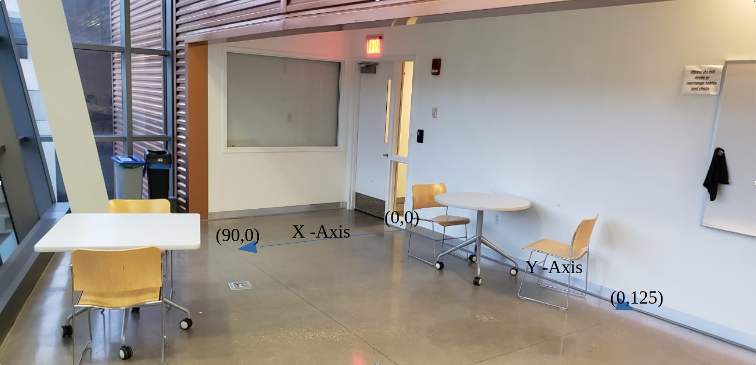
Collection of Data
23 Sets of X-Y coordinates on each coordinate 250 samples of RSSI data taken from 3 access points
Moving the target at a measured location from the origin
Each access points are individual features and the target location/X-Y coordinate or the label

Slide 2
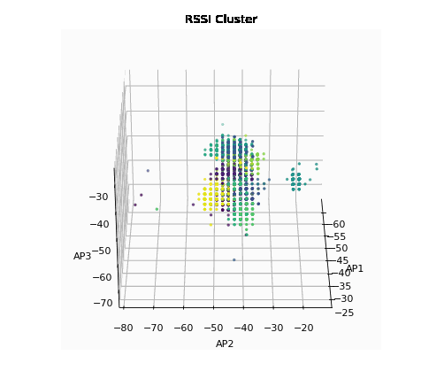
Data Analysis

Slide 3
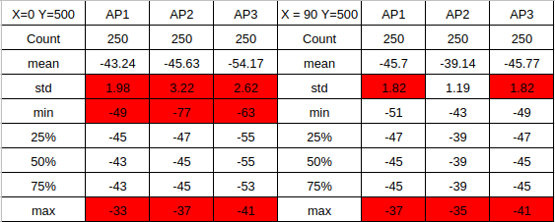
Data Analysis
Standard Deviation – Shows the spread of data from the mean
Interquartile Range – Very close to the mean that means the outliers are above 75% and below 25% range
Min/Max – Huge range causing massive overlap between the sets of data
On average the standard deviation was 1.78 that shows there is huge deviation from the mean

Slide 4
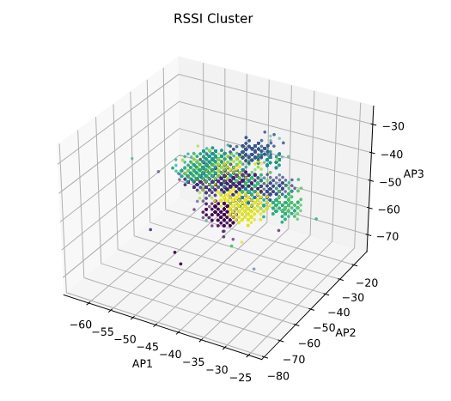
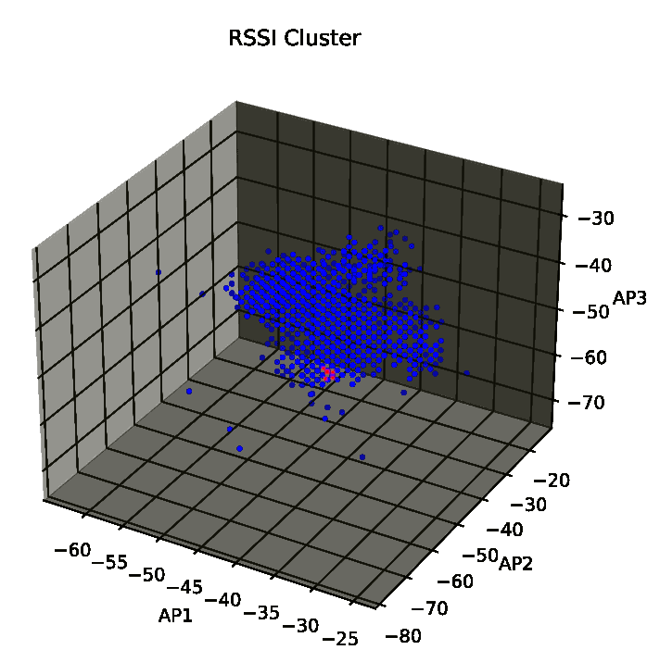
K-NN Algorithm
- knn classification algorithm chooses k nearest neighbors to predict the location of the target. The nearest neighbors are classified in different clusters the model predicts the cluster RSSI data packet belongs to, this coordinate for this cluster is returned.
- knn regressor each feature(Access points) is treated as continuous values. The nearest k neighbours and a linear regression model is used to predict the approximate coordinate for the target.

Slide 5
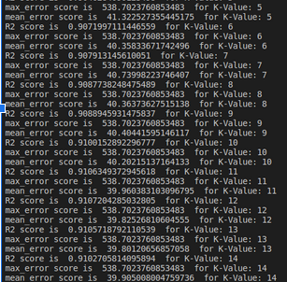
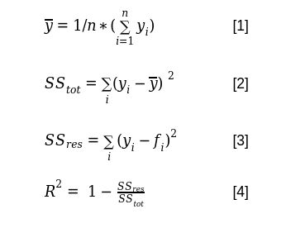
Testing
Max distance error - The maximum error the in the prediction within the testing set
Mean distance error - The mean distance error of all the predictions made by the model
R-2 score - The proportion of the variance in the dependent variable that is predictable from the independent variables[1]

Slide 6
Preprocessing Data
Interquartile range (IQR): is the difference between the 75th percentile (Q3) and the 25th percentile (Q1) in a dataset. It measures the spread of the middle 50% of values.[1]
Outliers = RSSI > Q3 + 1.5*IQR or RSSI < Q1 – 1.5*IQR [1]
Using the above equation the outliers are removed from the set of RSSI data points, once the outliers are removed, the mean of the remaining RSSI data points is used to predict the target locations X-Y coordinates.
Z-score: A z-score show how many standard deviations a given RSSI data point is from the mean.[1]
X is a single raw data value
μ is the mean
σ is the standard deviation
z = (X – μ) / σ [1]
Using z-score RSSI values that are 1.6 standard deviations away from the mean are removed from the set of RSSI data points, once the outliers are removed, the mean of the remaining RSSI data points is used to predict the target locations X-Y coordinates.

Slide 7
Conclusion
R2 score of 0.91
Mean error of 39 inch
Lacks robustness
Wide fluctuations still pose problems but the predictions closer to true location once the outliers are removed
Future Work
Kullback–Leibler-divergence kernel regression multivariate Gaussian
Jensen-Bregman divergence
Robust to random noise
Extending the model to N number of access points
Covering larger areas
Predict the floor and location of the target in three dimensions

